Slide 1

E-Commerce Development Plan and Website
Anna Domina

Slide 2

Executive Summery
BBLUA is set to transform online fashion shopping with its curated selection of timeless and elegant clothing items. As a premium e-commerce store, BBLUA aims to provide discerning customers with exceptional quality and style that transcends fleeting trends. With a focus on classic elegance, we are dedicated to delivering a seamless online shopping experience that caters to individuals seeking enduring fashion choices.

Slide 3

Product or Service Description
BBLUA specializes in offering a curated collection of timeless and elegant clothing, catering to individuals seeking enduring style and exceptional quality. We provide dresses, suits, blouses, trousers, and accessories from renowned designers known for their craftsmanship and classic aesthetics. Our focus is on filling the gap in the fashion market for those who appreciate refined pieces that transcend trends. BBLUA addresses the need for classic fashion choices in a trend-dominated industry, providing customers with the means to embrace enduring elegance and exceptional craftsmanship.

Slide 4

Marketing Analysis

Slide 5
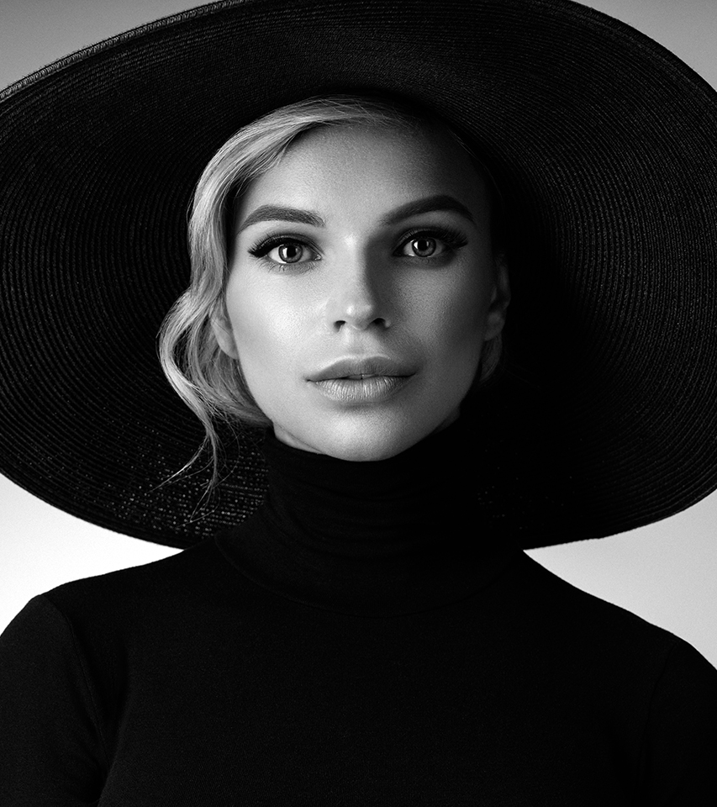
Target Market
BBLUA targets individuals aged 22 to 75 who appreciate sophistication, quality, and classic style. Professionals, socialites, and fashion-conscious individuals seeking versatile garments for various occasions comprise our core customer base.

Slide 6

User Persona 1
Erika S is 31 years old office manager, who thrives in organizational tasks and ensuring smooth operations. She enjoys her role in coordinating various office activities and maintains a professional demeanor. Her fashion choices reflect her need for versatility and a polished appearance. Erika prefers using her desktop computer for online shopping, making the most of her breaks at the office or evenings at home. The larger screen provides a better view of product details, and she appreciates the ability to compare options effectively.

Slide 7

User Personas 2
Maggie B is 55 years old writer with a wealth of experience in her field. She has a passion for storytelling and spends her time working on novels, essays, and articles. Her writing style is reflective and insightful, often drawing from her life experiences. Maggie is accustomed to using her smartphone for various tasks, including shopping for clothing. She appreciates the convenience and simplicity of mobile shopping. As someone who values comfort and classic elegance, she seeks clothing that aligns with her mature yet creative style.

Slide 8
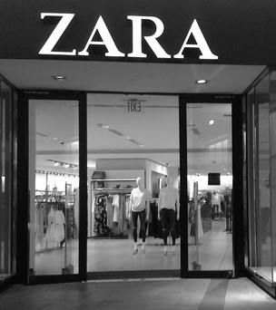
Competitors: ZARA
Strengths:
Global Reach: ZARA's extensive global presence provides accessibility to a wide customer base.
Fast-Fashion Model: ZARA's quick production and distribution allow them to respond rapidly to current trends.
Affordability: Their competitive pricing attracts budget-conscious shoppers.
Weaknesses:
Quality Concerns: Rapid production can sometimes result in compromised quality.
Lack of Timelessness: ZARA's focus on trends might not appeal to customers seeking classic and enduring styles.
This Photo by Unknown Author is licensed under CC BY

Slide 9
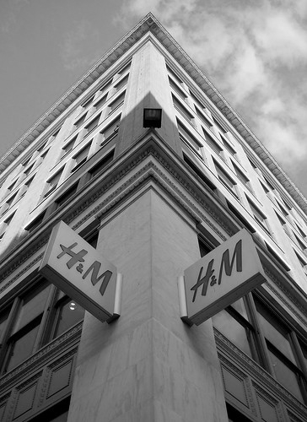
Competitors: H&M
Strengths:
Brand Collaborations: H&M's partnerships with designers and celebrities enhance their brand appeal.
Sustainable Initiatives: Their efforts toward sustainability attract environmentally conscious consumers.
Affordable Fashion: H&M's affordable pricing caters to a wide range of customers.
Weaknesses:
Quality Variation: Similar to ZARA, inconsistent quality can impact customer satisfaction.
Trend-Centric: H&M's focus on fast-changing trends might not resonate with those seeking timeless fashion.
This Photo by Unknown Author is licensed under CC BY-ND

Slide 10

Competitors: asos
Strengths:
Extensive Selection: ASOS offers a vast range of styles, catering to various tastes and preferences.
Online Platform: Their e-commerce platform provides a convenient shopping experience.
Global Shipping: ASOS's international shipping options broaden their customer reach.
Weaknesses:
Overwhelming Choices: The sheer volume of options might be daunting for customers seeking specific styles.
Diluted Messaging: ASOS's diverse range might make it challenging to establish a strong niche identity.

Slide 11
Conclusion
BBLUA stands out by focusing exclusively on timeless elegance and exceptional quality. Unlike fast-fashion giants, we curate a refined collection of enduring styles that cater to those who value lasting fashion choices. Our emphasis on craftsmanship, classic aesthetics, and attention to detail sets us apart from competitors. By offering customization options and a personalized shopping experience, we cater to individual preferences and encourage long-term investment in wardrobe essentials. Additionally, our premium fashion content and workshops offer added value, creating a community of individuals who share a passion for classic elegance.

Slide 12
Operations Plan

Slide 13

Day-to-Day Operations: The day-to-day operations of BBLUA will revolve around managing our e-commerce platform, ensuring smooth customer interactions, and curating the collection. This includes updating product listings, responding to customer inquiries, analyzing sales data, and creating engaging content for marketing.
Business Model: BBLUA will operate as an e-commerce-only business, leveraging the digital realm to reach our target audience. While we'll start exclusively online, we might consider occasional pop-up events in the future to provide a tangible shopping experience.

Slide 14
Product Acquisition and Shipping: We will establish partnerships with renowned designers who align with our brand's aesthetic. Once products are selected, we'll procure inventory from these designers. For shipping, we'll collaborate with a reliable logistics company to ensure efficient and timely deliveries to customers.
Supplier Relationships: Our suppliers will consist of established designers and brands renowned for their craftsmanship and classic aesthetics. These partnerships will be crucial to maintaining the quality and uniqueness of our collection.
Inventory Storage: Initially, we will operate as a dropshipping model, minimizing the need for physical inventory storage. As we grow, we may consider renting storage space or using third-party fulfillment centers to streamline operations.

Slide 15
Employee Requirements: In the early stages, a lean team will suffice, including roles such as a founder/manager, website manager, customer support representative, and content creator. As the business expands, roles related to marketing, logistics, and product curation may be added.
Marketing and Content Creation: A content creator will be responsible for creating engaging content, including blog posts, social media updates, and fashion guides. This content will establish BBLUA as an authority in timeless elegance and contribute to our brand's online presence.
Financial Management: We'll implement a robust financial management system to track sales, expenses, and profits accurately. This will involve using accounting software or services to ensure proper financial reporting and tax compliance.

Slide 16
Conclusion
Overall, BBLUA's day-to-day operations will focus on managing the e-commerce platform, curating the collection, customer engagement, and content creation. Our commitment to quality, customer satisfaction, and a seamless online shopping experience will be at the core of our operations. As the business evolves, we'll adapt our operations to support growth and maintain the exceptional service we promise to our customers.

Slide 17
Marketing Plan

Slide 18
Marketing Channels
Social Media
Influencer Collaborations
Email Marketing
Online Advertising
Utilize platforms like Instagram and Pinterest to showcase our curated collection, engage with our audience, and share fashion inspiration.
Partner with fashion influencers who align with our brand's aesthetic to reach a wider audience.
Develop insightful blog posts, fashion guides, and designer spotlights on our website to establish ourselves as an authority in timeless elegance.
Content Marketing
Send regular newsletters to subscribers featuring new arrivals, styling tips, and exclusive offers.
Use targeted ads on social media platforms and Google to reach potential customers interested in classic fashion

Slide 19
Target Customer Meeting Points
Online Fashion Communities
Writer and Creative Networks
Fashion Event
Engage in relevant online forums and communities where individuals seek timeless and elegant fashion advice.
Connect with platforms or events frequented by writers and creatives who appreciate refined style.
Participate in fashion-related events and exhibitions to showcase our brand and connect with potential customers.

Slide 20
Marketing Strategy
Customer Attraction Strategies:
Referral Program: Incentivize existing customers to refer friends by offering discounts or rewards for successful referrals.
Digital Strategies:
Search Engine Optimization (SEO): Optimize website content for keywords like "timeless fashion," "elegant clothing," and "classic style."
Search Engine Marketing (SEM): Use Google Ads to target relevant keywords and appear in search results for classic fashion searches.
Content Marketing Strategy: Our content strategy will focus on providing value and inspiration to our audience. We'll create:
Fashion Guides: Detailed guides on building a timeless wardrobe, accessorizing, and styling tips.
Designer Spotlights: Showcasing the stories behind our featured designers to build a connection with our customers.
How-to Articles: Step-by-step articles on caring for quality garments to extend their lifespan.
Limited-Time Offers: Introduce special discounts or offers for first-time customers to encourage their initial purchase.
Customer Engagement:
Personalized Recommendations: Leverage customer browsing history and preferences to offer tailored product recommendations.
Interactive Content: Use polls, quizzes, and interactive stories on social media to engage customers and gather insights.

Slide 21
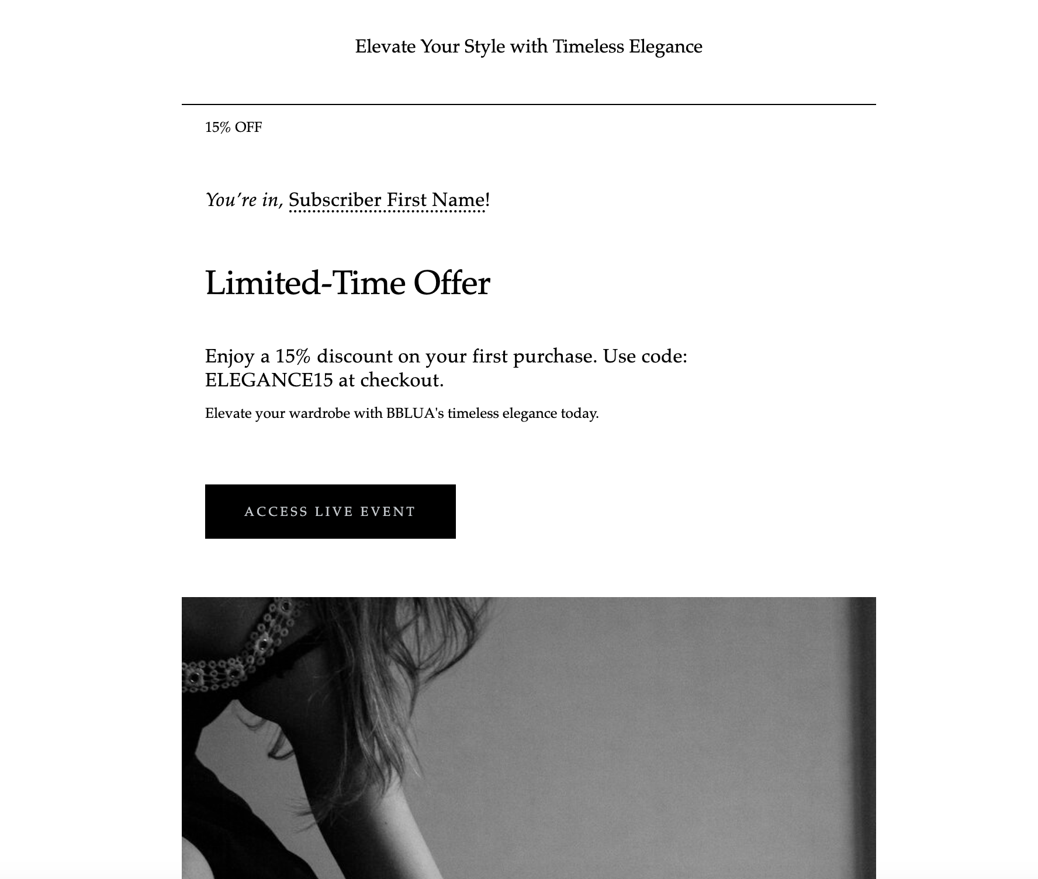
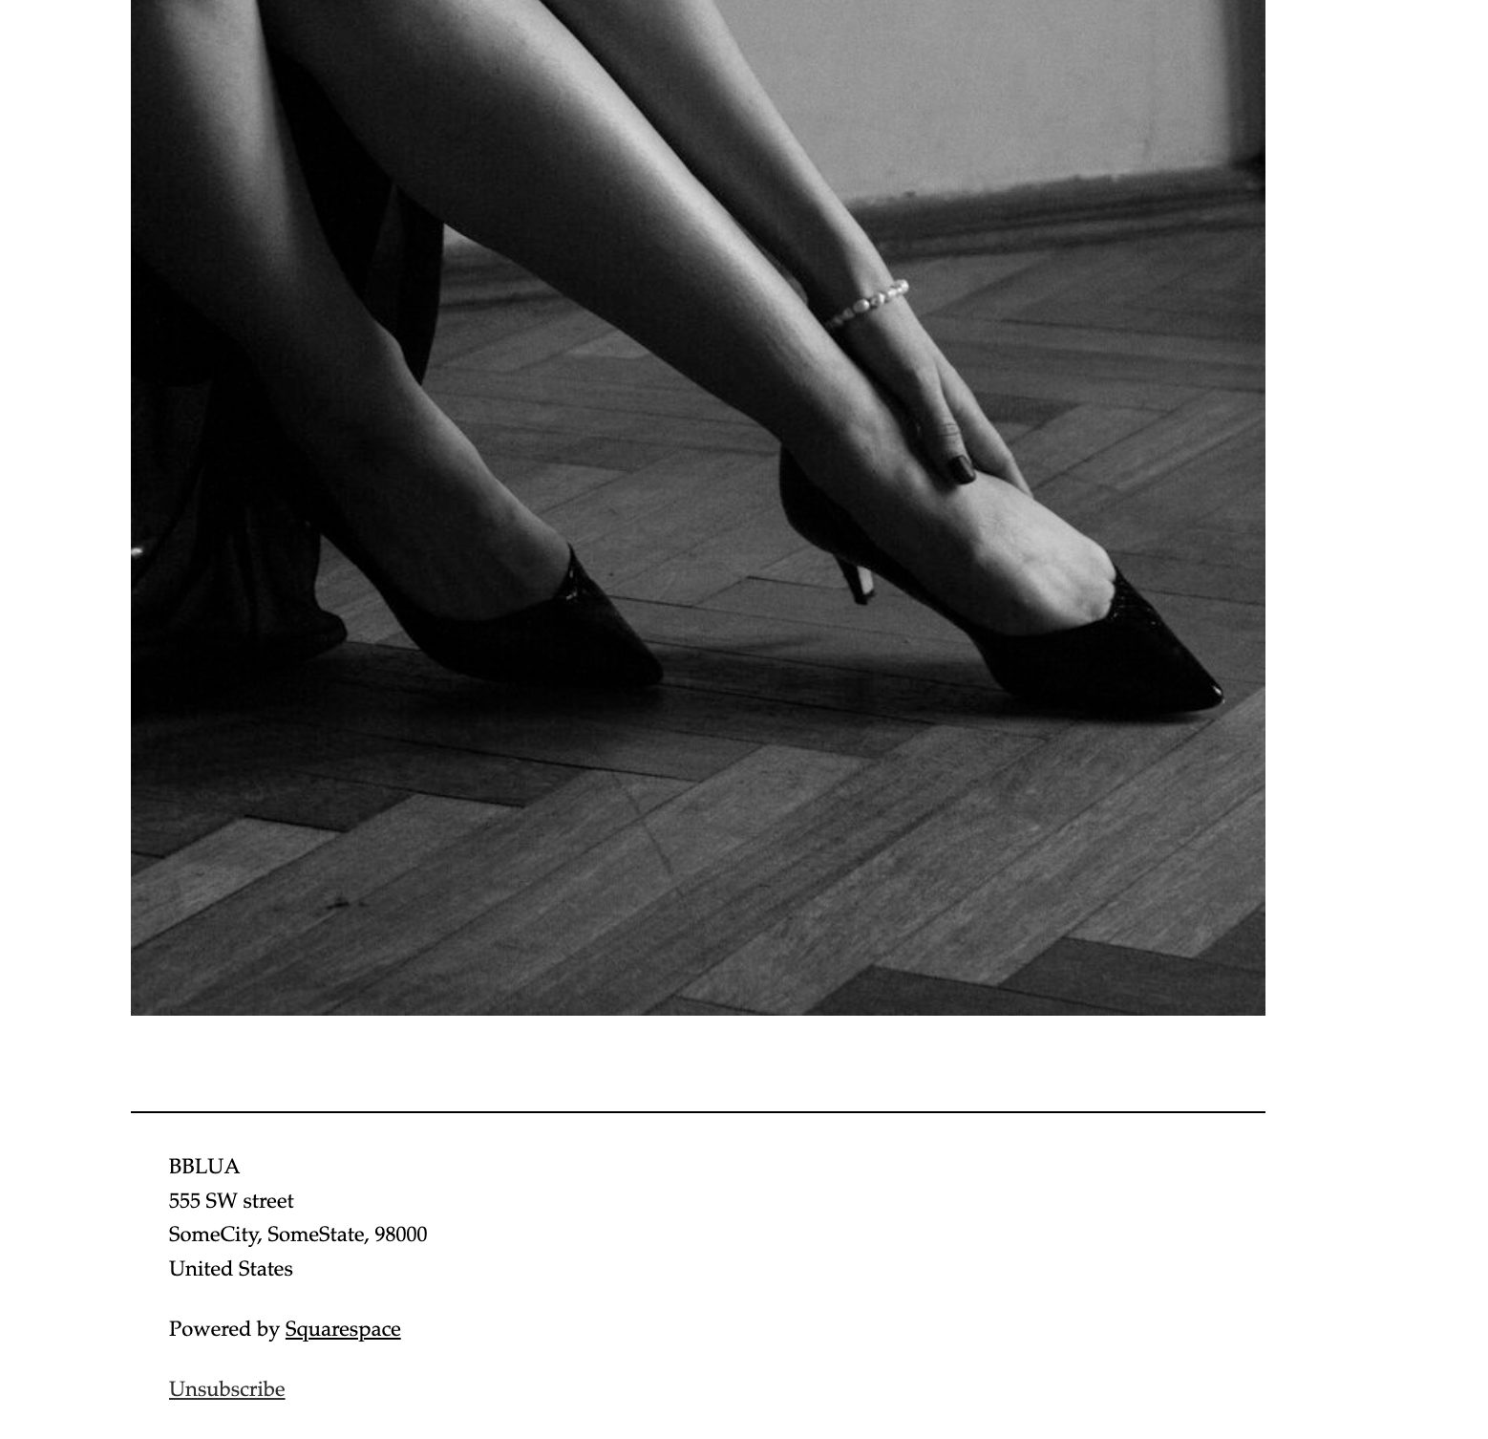
Examples of Email Advertising

Slide 22
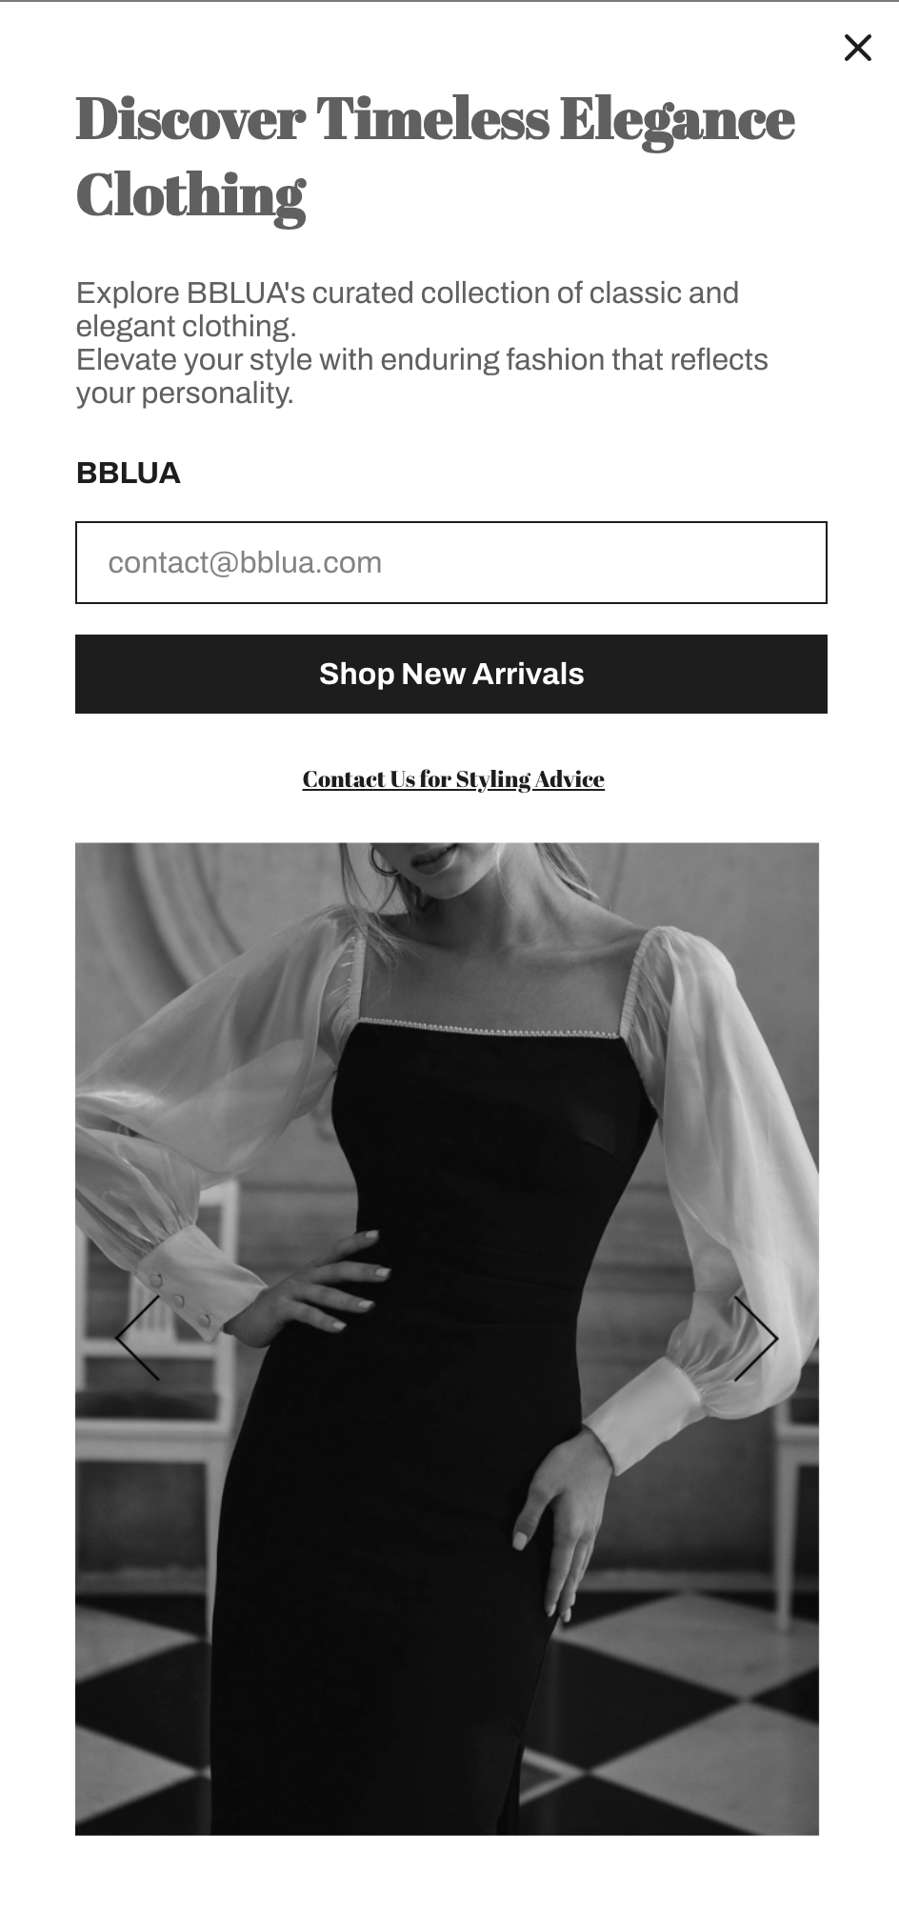
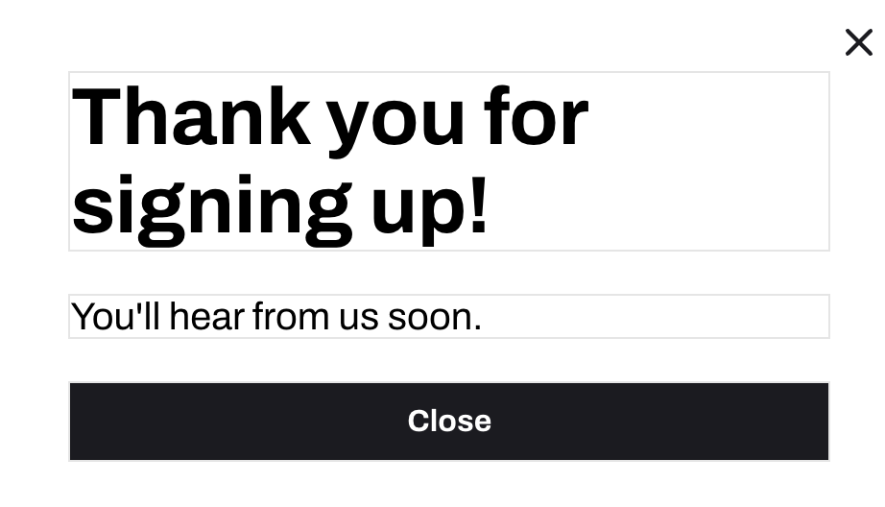
Subscription Popup

Slide 23
Sales Funnel

Slide 24
Steps
1. Attracting Visitors
2. Keeping Visitors Engaged
3. Encouraging Return Visits
4. Encouraging Purchase
5. Encouraging Additional Purchase
6. Ensuring Smooth Checkout
7. Post-Purchase Communication

Slide 25
1. Attracting Visitors
Social Media Engagement: Engage with target customers on platforms like Instagram and Pinterest through visually appealing posts, fashion inspiration, and interactive content.
Influencer Partnerships: Collaborate with fashion influencers to promote BBLUA and reach their followers.
Content Marketing: Create valuable blog posts and guides about timeless fashion, drawing organic traffic through search engines.
Paid Advertising: Utilize Google Ads and social media ads to target users searching for classic fashion and elegance.

Slide 26
2. Keeping Visitors Engaged
High-Quality Imagery: Display stunning images of clothing, showcasing their craftsmanship and elegance to captivate visitors.
Interactive Content: Use quizzes or polls on the website to engage users and offer personalized style recommendations.

Slide 27
3. Encouraging Return Visits
Email Subscriptions: Offer exclusive discounts in exchange for email subscriptions, allowing you to notify subscribers about new arrivals and promotions.
Retargeting Ads: Implement retargeting ads to remind visitors about their interest in BBLUA, encouraging them to return and make a purchase.

Slide 28
4. Encouraging Purchase
Limited-Time Offers: Display limited-time discounts on select items to create a sense of urgency.
Product Recommendations: Suggest related products based on the customer's browsing and purchase history.

Slide 29
5. Encouraging Additional Purchases
Cross-Selling: Offer complementary accessories or items that enhance the purchased product, encouraging customers to add more to their cart.
Reward Program: Introduce a loyalty program where customers earn points for each purchase, redeemable for discounts on future purchases.

Slide 30
6. Ensuring Smooth Checkout
User-Friendly Interface: Design an intuitive and straightforward checkout process with minimal steps and clear calls-to-action.
Guest Checkout Option: Provide the option for guest checkout to streamline the process for first-time customers.

Slide 31

7. Post-Purchase Communication
Order Confirmation: Send an immediate confirmation email after purchase, including order details and estimated delivery dates.
Shipping Updates: Send tracking information and updates as the customer's order is processed and shipped.
Follow-Up Surveys: After the product is received, send a survey to gather feedback and assess customer satisfaction.
Exclusive Offers: Periodically send email newsletters with exclusive offers, showcasing new arrivals and promoting ongoing sales.

Slide 32

Communication Timeline
Immediately After Purchase: Order confirmation email with order details and estimated delivery date.
1-2 Days Before Delivery: Send an email with tracking information and a reminder of the upcoming delivery.
1-2 Weeks After Delivery: Follow-up email with a customer satisfaction survey and request for product reviews.
Monthly: Newsletter with curated content, new arrivals, and exclusive offers.

Slide 33
E-commerce Platform

Slide 34
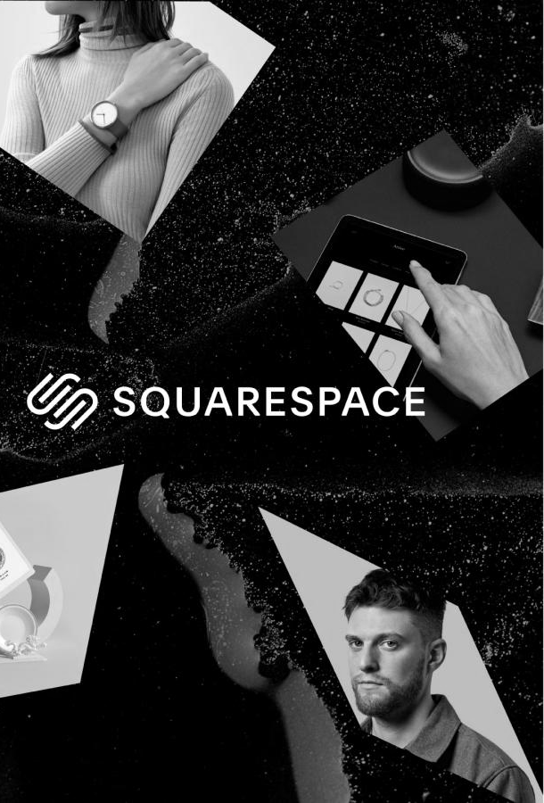
Squarespace
Choosing Squarespace as the e-commerce platform for BBLUA is primarily driven by its user-friendly interface, elegant design templates, and the smooth integration of e-commerce features. Squarespace offers a variety of options for customization, allowing us to create an online store that not only looks visually appealing but also functions seamlessly. With this platform, we have access to tools that are essential for managing our inventory, processing orders efficiently, and effectively interacting with our customers.
Squarespace offers a range of pricing plans, including Business, Basic Commerce, and Advanced Commerce options. These plans come with monthly costs that fall between $18 and $40 when paid on an annual basis. The higher-tier plans offer additional advanced e-commerce features like recovering abandoned carts and enabling gift card usage, among other benefits. The decision regarding the plan to choose will be based on BBLUA's specific requirements and growth expectations.
This Photo by Unknown Author is licensed under CC BY-NC

Slide 35
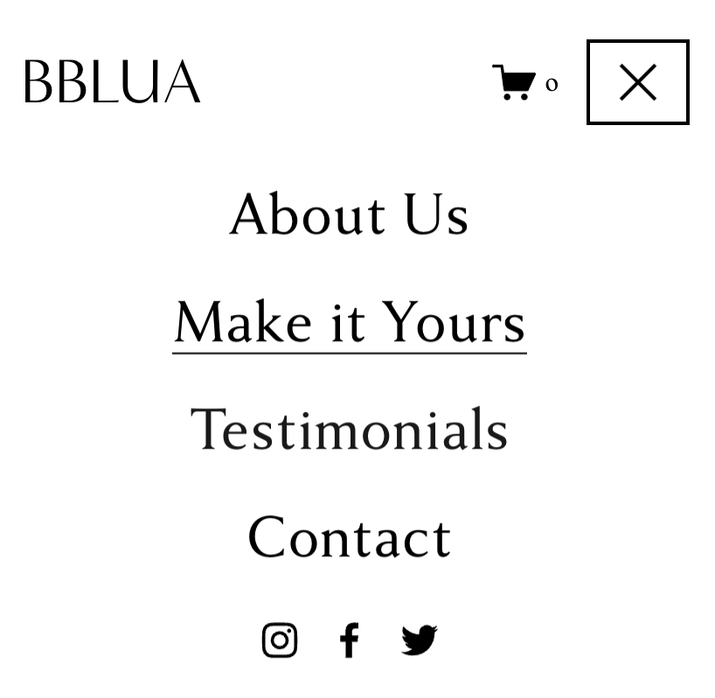

Store organization
The BBLUA e-commerce store will feature a well-organized layout to enhance user experience and streamline navigation. The store will have two main categories: "Accessories" and "Clothing," catering to those seeking refined fashion solutions. Each category will be further subdivided into subcategories for ease of browsing.
Accessories Category:
Subcategories: Handbags, Jewelry, Scarves, Belts
Products: Exquisite handbags, elegant jewelry pieces, luxurious scarves, and sophisticated belts.
Clothing Category:
Subcategories: Dresses, Suits, Blouses, Skirts
Products: Timeless dresses for various occasions, tailored suits for a professional look, elegant blouses, and classic skirts.

Slide 36
Supporting the Sales Funnel
Link: swordfish-haddock-x5er.squarespace.com
Password: BbLUA2023!

Slide 37
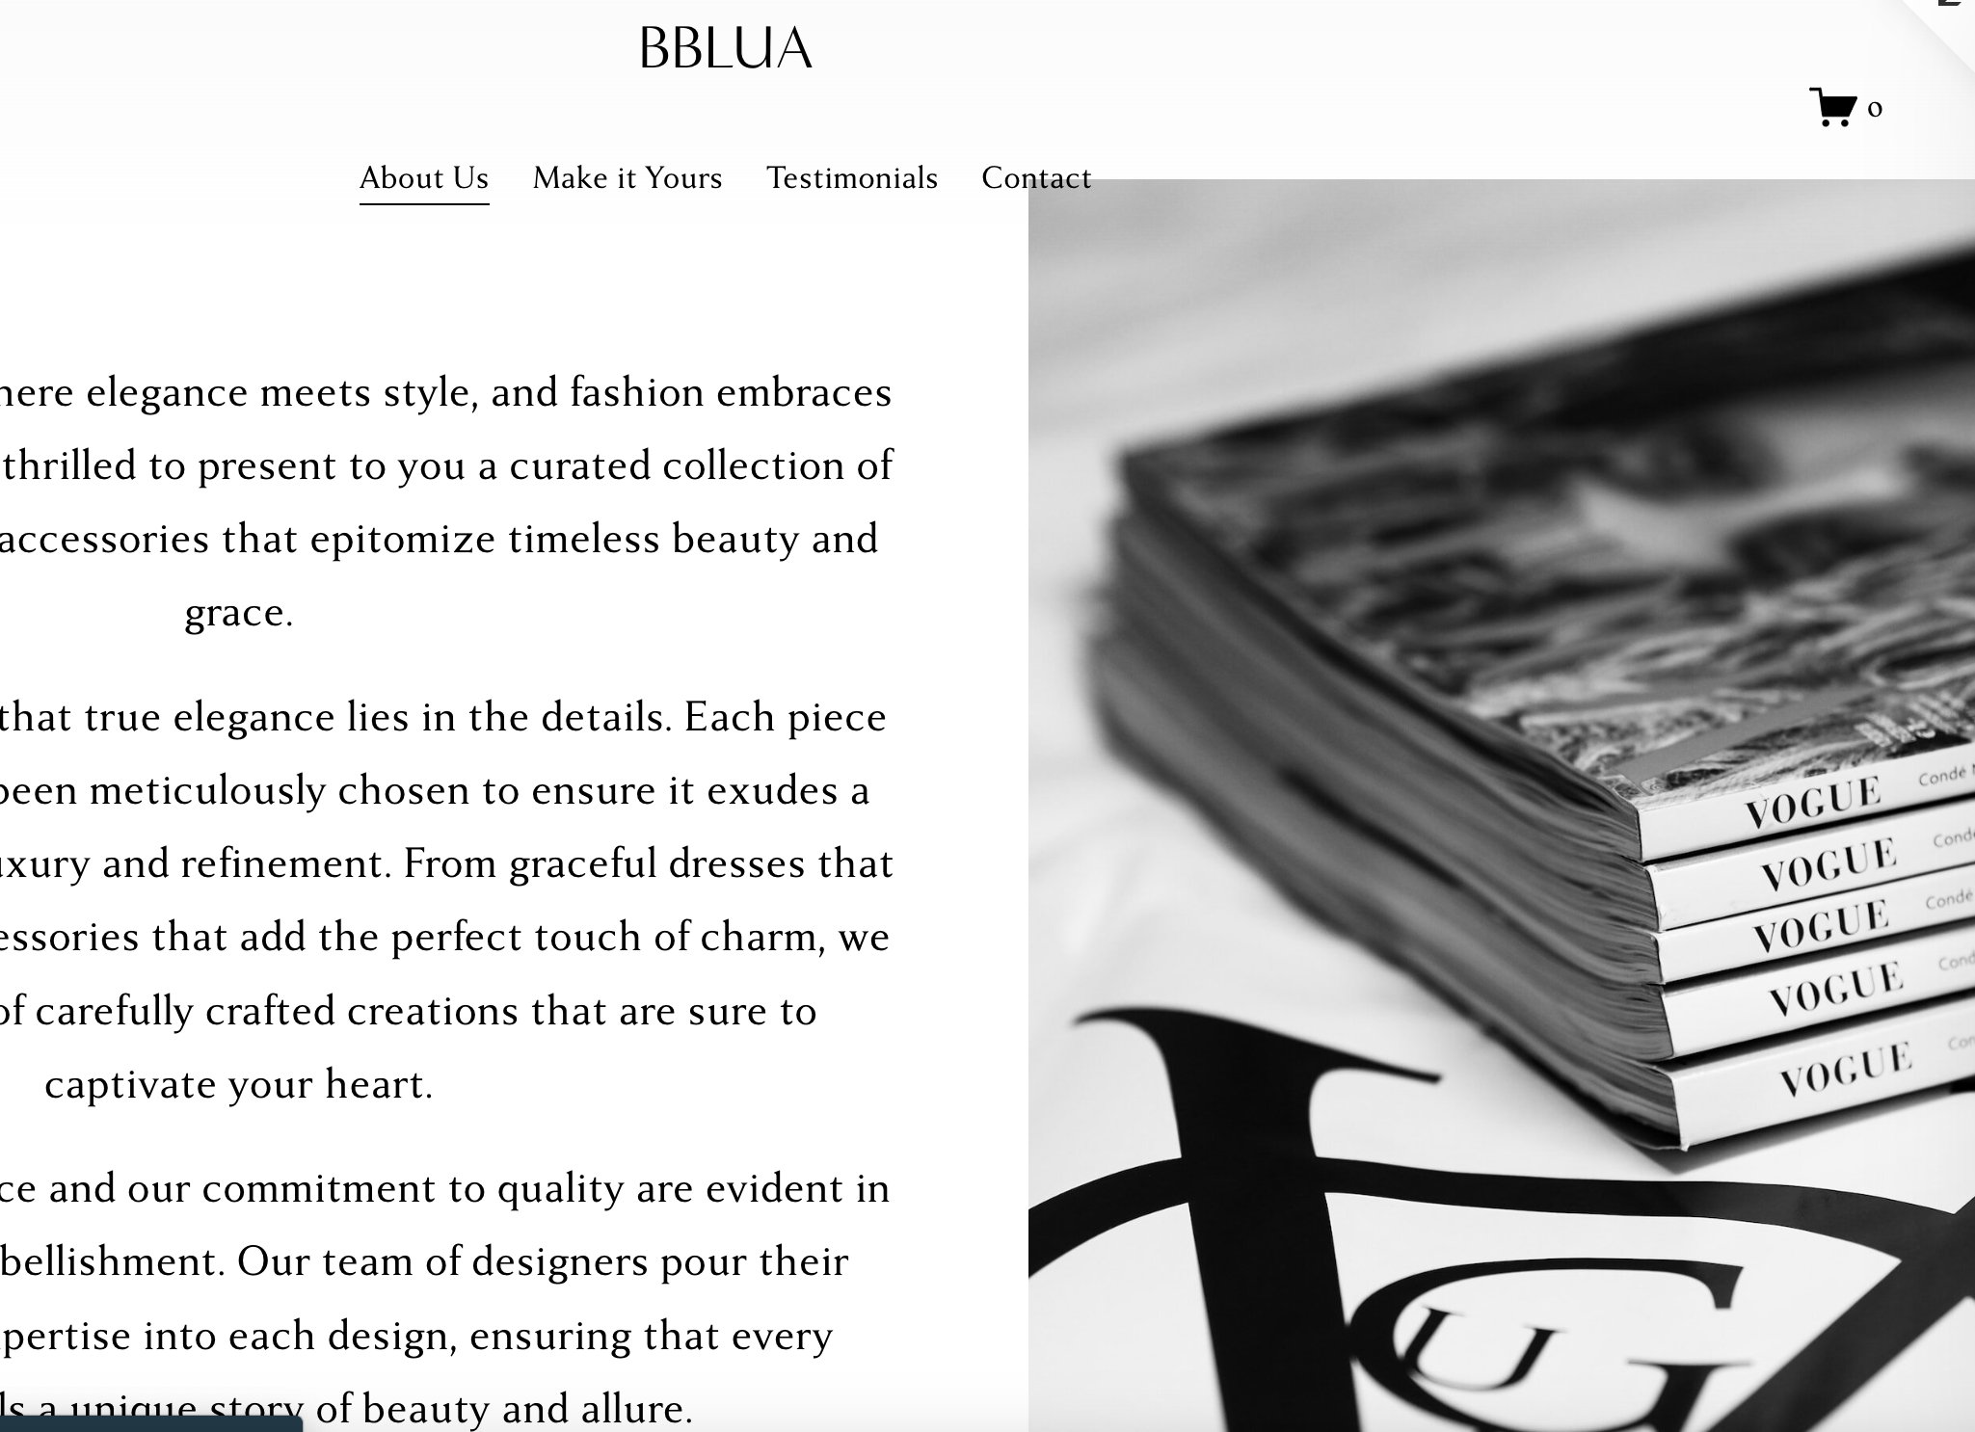
About BBLUA
The “About Us” page will offer visitors insights into the brand's mission, values, and the story behind its establishment. This page will help build a connection between the brand and its audience, fostering a sense of authenticity and trust.

Slide 38
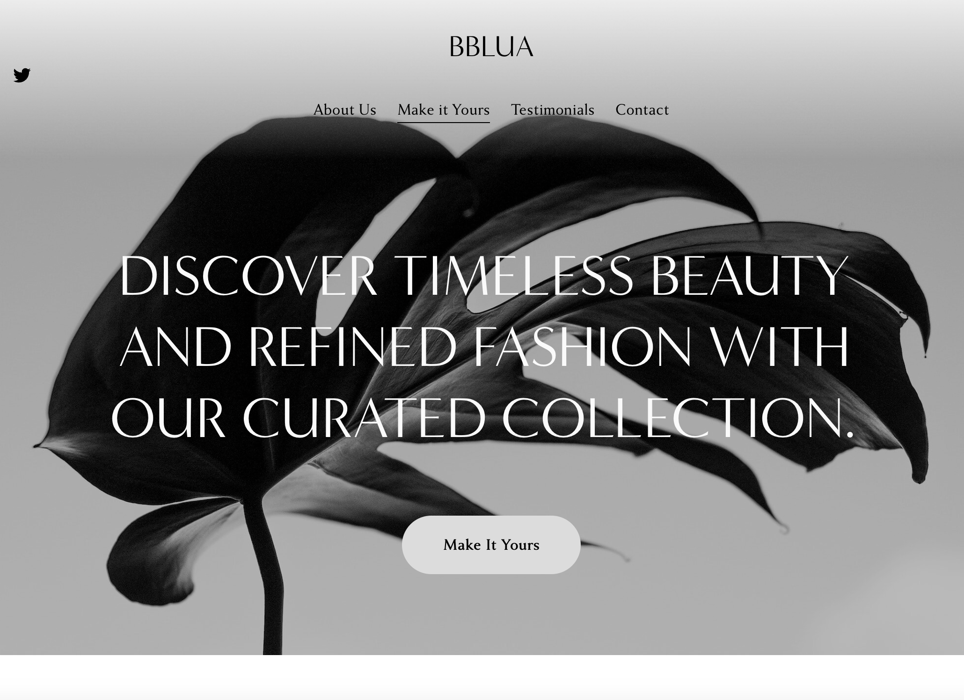
Landing page
Landing page CTA: The CTA on the landing page is displayed as “Make It Yours” button, which will encourage visitors to brows the collections.

Slide 39
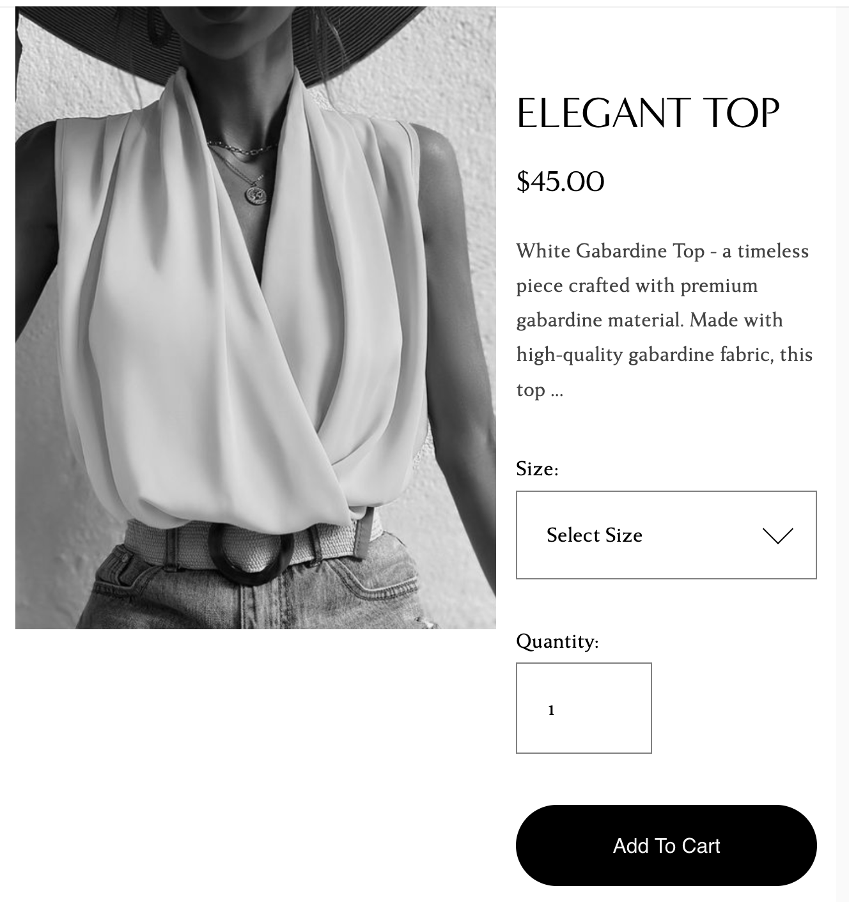
Product Customization
Customers will have the option to select their preferred size, color, and quantity for the products they wish to purchase. This customization feature enhances the personal shopping experience and caters to individual preferences.

Slide 40
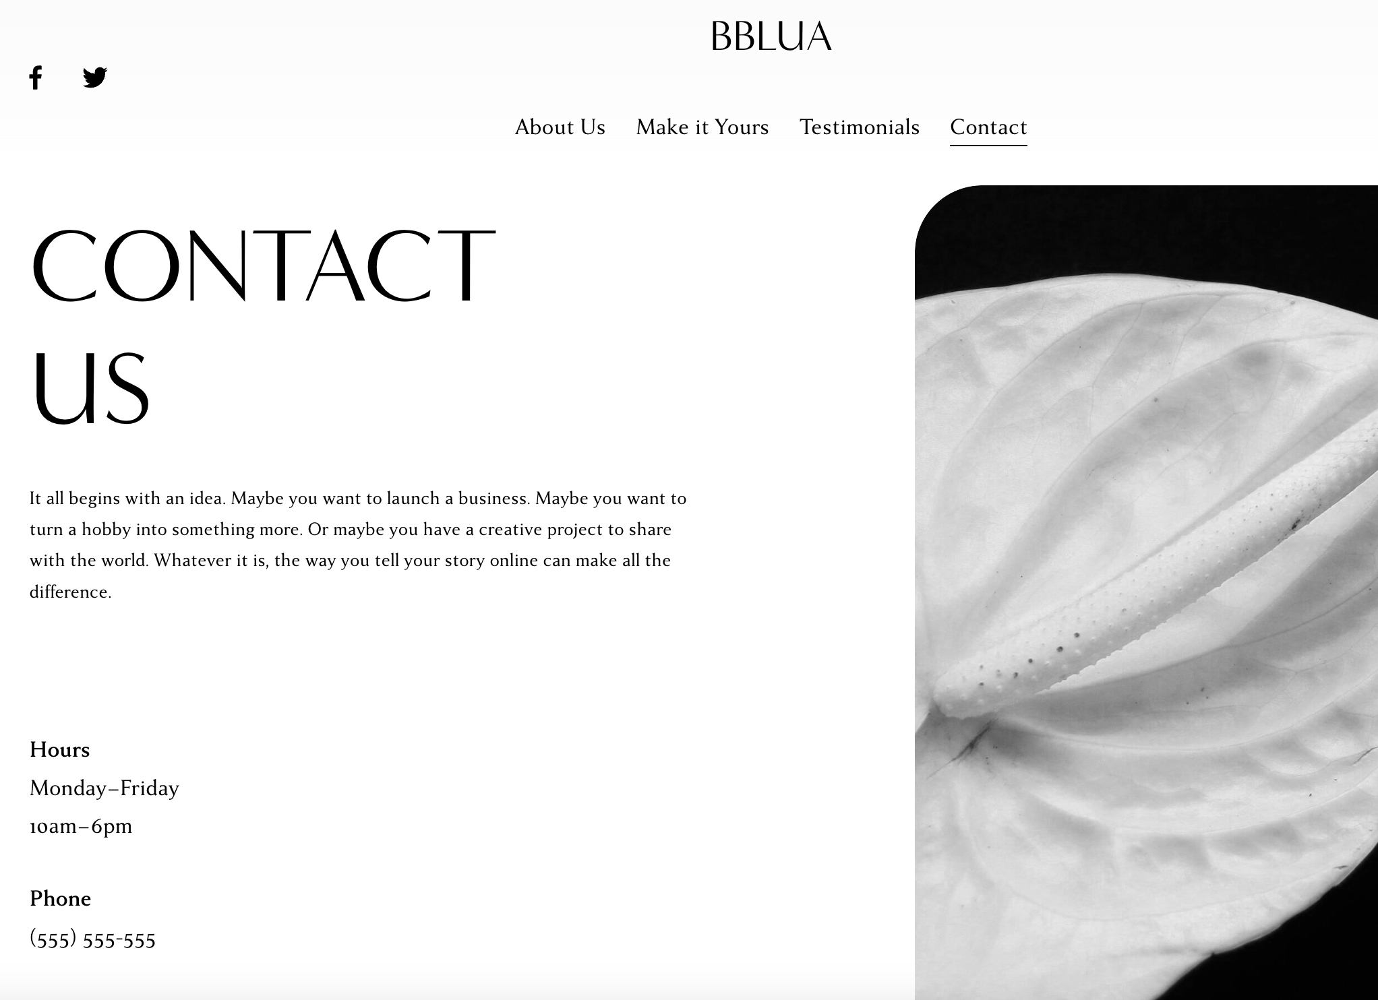
Customer Support
The "Customer Support" or "Contact" page will offer multiple channels for customers to get in touch, including a contact form, email address, and possibly a phone number. Providing exceptional customer support will foster trust and satisfaction among visitors.

Slide 41
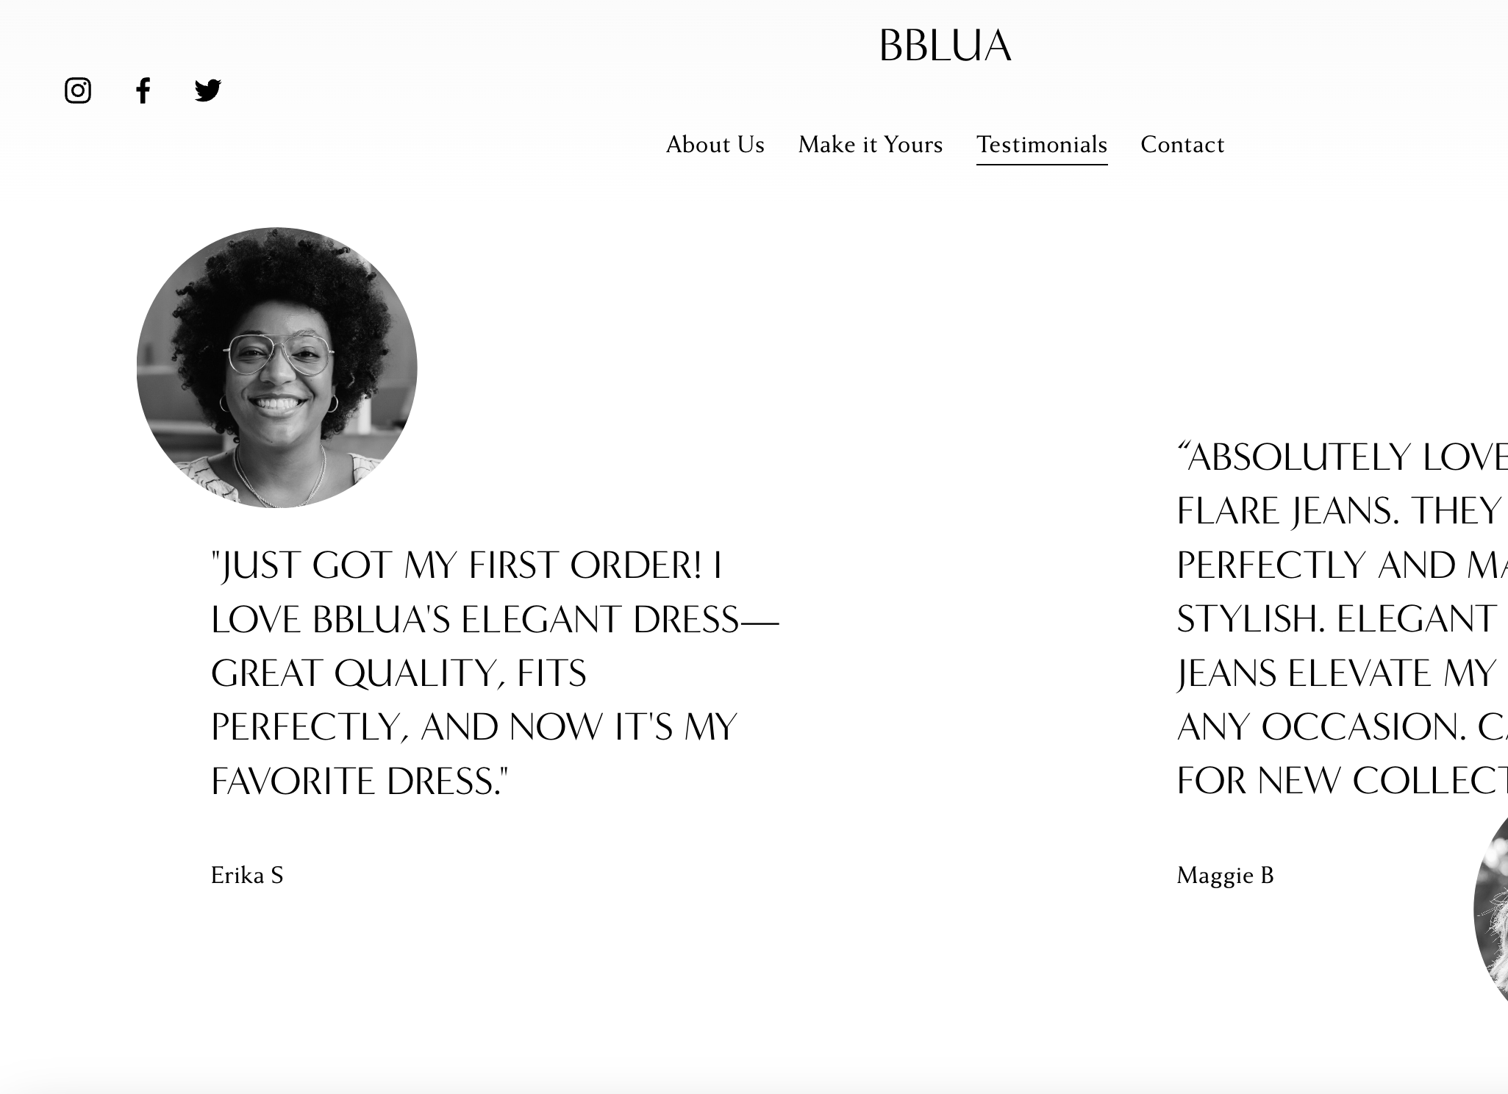
Testimonial Page
The "Testimonials" page will showcase genuine feedback from satisfied customers, highlighting their positive experiences with BBLUA's products and services. This page will further strengthen the brand's reputation and provide social proof to potential buyers.

Slide 42
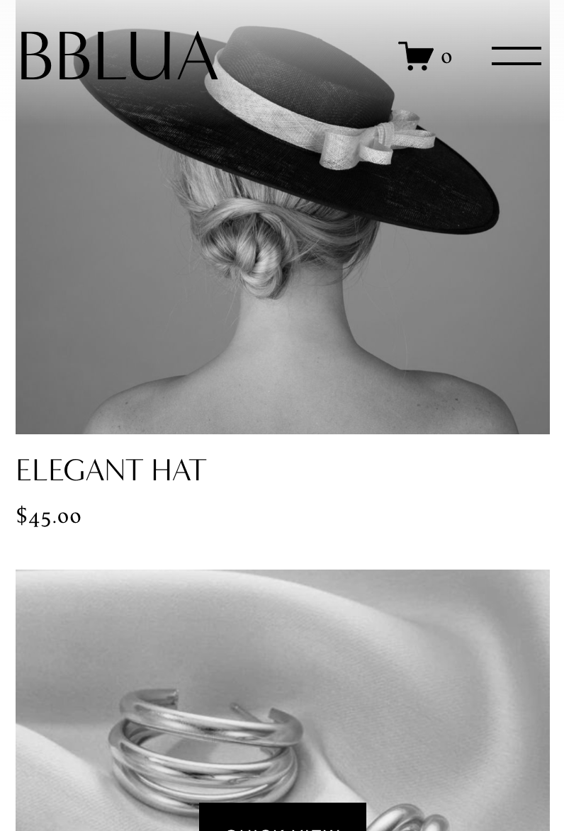
Additional Features
Blog Platform: BBLUA can create engaging and informative blog posts directly within the platform, connecting with its audience and providing valuable insights into classic fashion trends, styling tips, and industry news.
Image Galleries: BBLUA can showcase high-quality images of its products and fashion inspirations using image galleries, enhancing the visual appeal of the website.
Video Integration: If BBLUA plans to incorporate videos, Squarespace allows seamless integration of video content to enhance the visitor experience and convey brand messages effectively.

Slide 43
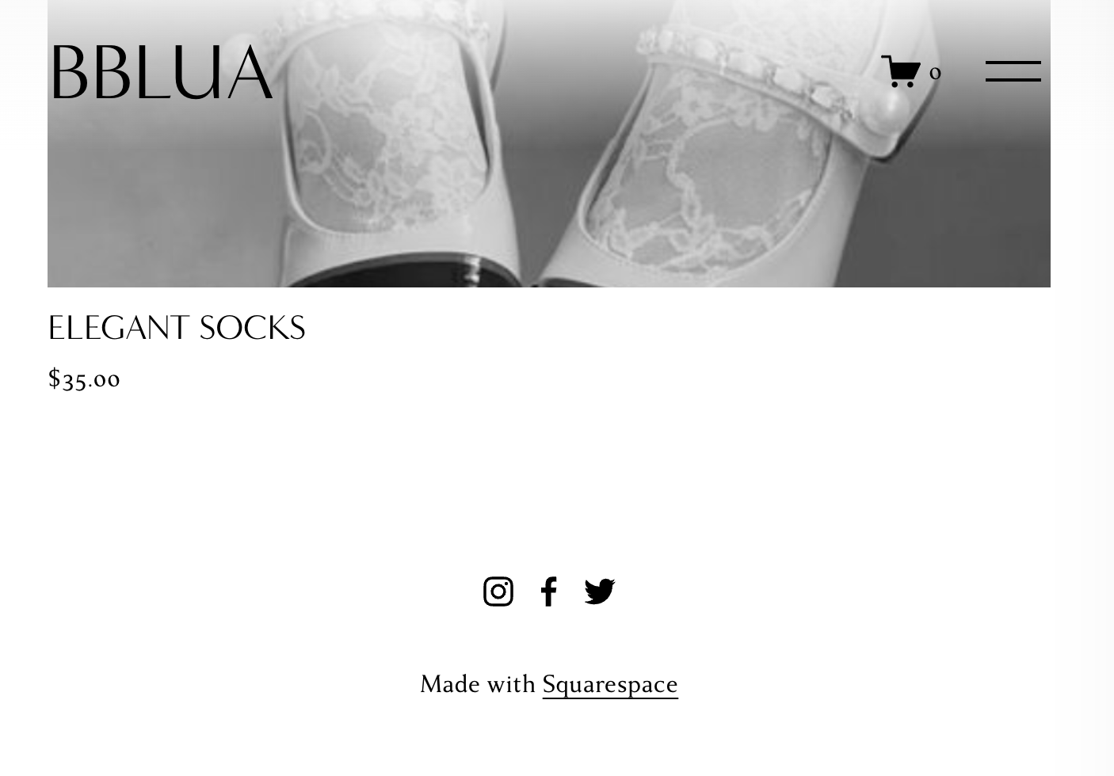
Integrate with other content marketing plans
Squarespace easily connects with content marketing, allowing BBLUA to share blog posts on social media and in emails for broader reach. This, along with integrating product reviews and creating valuable content, helps BBLUA engage customers, build trust, and establish itself as a respected name for timeless fashion.

Slide 44
The end

